Slide 1
ETICS market in Poland: current status and future perspectives
Riga 16st of March, 2016
Dr eng. Mariusz Garecki; Chairman of Technical Comision - Polish Association for ETICS

Slide 2
ETICS systems: main technical functions
Improving thermal insulation of external wallshal insulation of external walls
Elimination or reduction of thermal bridges
Protecting the partition from exposure to of atmospheric factors
…….
Improving the aesthetics of the façade

Slide 3
European ETICS market size: app. 170 mln sq.m
Division between different insolation products

Slide 4
PL: ETICS market size
Year | Market size
2013 | Polish ETICS market has been and remains very stable at the average level of 40 mln m2 per year
2014
2015 forecast

Slide 5
PL: ETICS market status
Division between different insolation products
Insulation products | Market share ETICS
Polystyrene EPS | 85%
Mineral wool MW | 15%
Polystyrene XPS | N/A
Phenolic foam PF | N/A
Polyurethane PU | N/A
Others, e.g. wood fibre | N/A
Source: TNS Polska, 2015, declaration of construction companies interviewed in the poll

Slide 6
PL: ETICS market status
ETICS manufacturers – comparison of market perceptions 2011-2017
[%]
ETICS market
Construction market
Diagnosis
Forecast
worse
the same
better

Slide 7
PL: ETICS market status Range of changes in requirements for insulation of external walls in years 1966-2021

Slide 8
PL: ETICS market status Range of changes in requirements for insulation of external walls in years 1966-2021
Low energy buildings < 0,15 [W/m2*K]

Slide 9
PL: ETICS market status
Average insulation thickness – EPS
Source: TNS Polska

Slide 10
PL: ETICS market status
Average insulation thickness – MW
Source: TNS Polska

Slide 11
PL ETICS market development
Summary
Specific developments / additional remarks
Very competitive market (presence of all international ETICS as well as many strong national producers)
Very well developed ETICS technology
Huge potential for the industry in renovation of buildings insulated in the 90’s
Low awareness of challenges for building industry linked to sustaible development
Despite of growing quality of work provided by erections companies over ¼ of buildings being insulated with no warranty from ETICS producer due to usage of non-system products (Source: TNS Polska, declaration of construction companies)
From 2016 new legal tools for construction supervision to control the market may improve the usage of system products

Slide 12
ETICS: trends on the facades – basic directions

Slide 13
Trends on the facades: main directions
energy saving: as a target - better insolation (thickness of themo insolation depends from kind of thermal insolation - λ factor ), „ETICS on ETICS” technology,
safety: e.q. anchoring of system, durability, fire resistance,
real energy saving for ETICS: elimination of thermo bridges,
highly durable facades,
better workability parameters, faster application solutions,
active facades – energy generation,
fasades with function of energy acumulation,
Thermo reflection layers,
aesthetics facades: new possibilities.

Slide 14
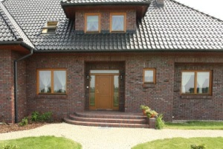
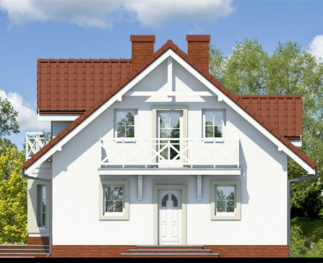
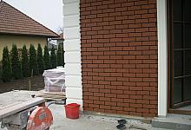
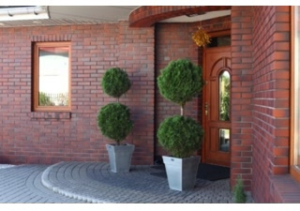
Trends in Facades Traditional solutions – single family houses

Slide 15
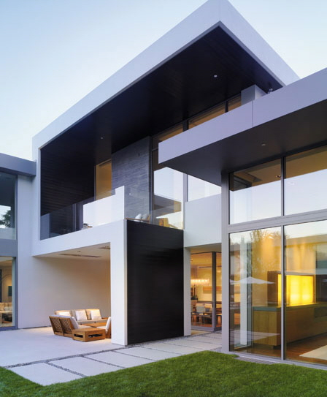
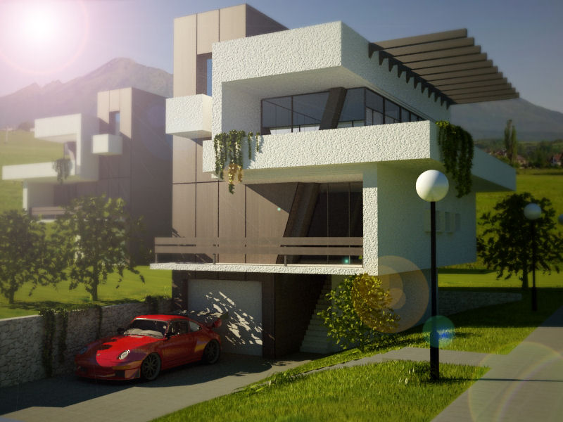
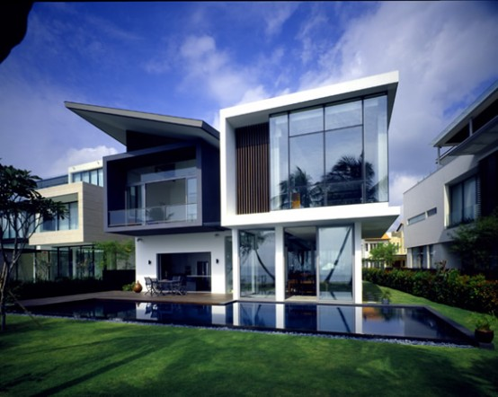
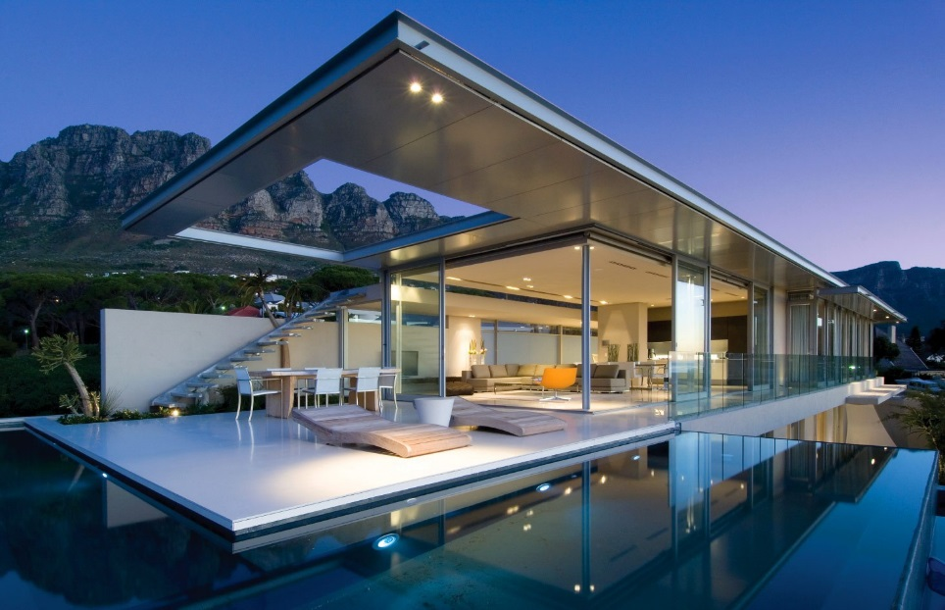
Trends in Facades Modern solutions– single family houses

Slide 16
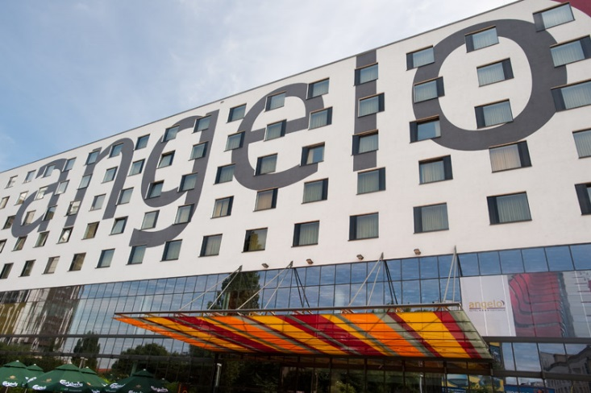
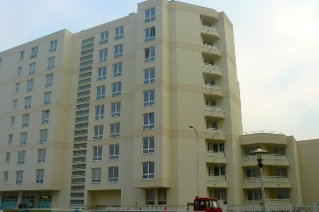
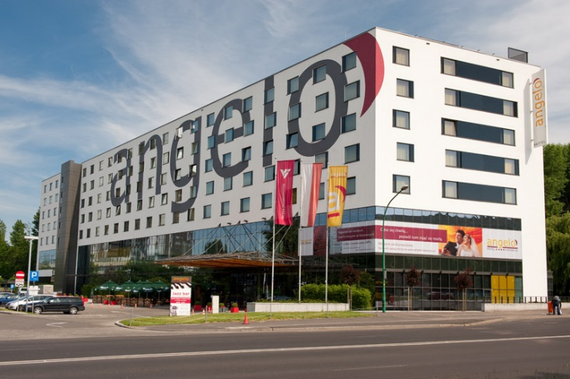
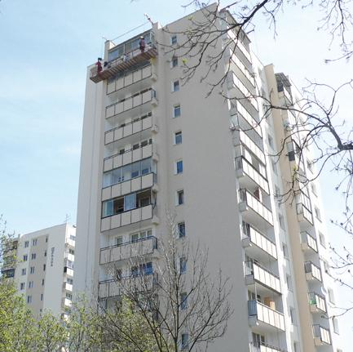
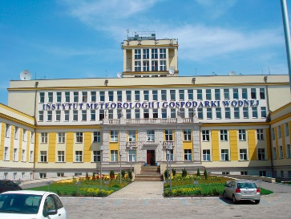
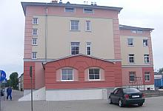
Trends in Facades Multifamily block of flats

Slide 17
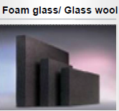
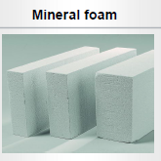
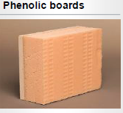
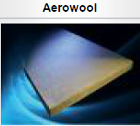
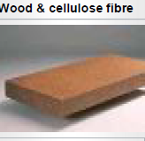
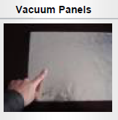
Energy saving: better thermal insolation Alterntive insolation materials

Slide 18
Energy saving: better thermal insolation
Comparison of λ factors for different insolation materials

Slide 19
Energy saving: better thermal insolation
Comparison thickness of insolation materials for the same thermal resistance factor R [m2*K/W]

Slide 20
Energy saving: better thermal insolation Alterntive insolation materials: λ factor vs. required thickness of insolation layer for the same R value (thermal resistance)
Thermo insolation layer thickness
thickness of insolation
will influence on
total weight of ETICS system
Mass of thermo insolation layer for require thickness in different periods

Slide 21
Energy saving: better thermal insolation How greater thickness of insulation will influence on the system?
increasing the torque operating on anchors: required to increase length and load of anchors
increasing thickness of insulation layer will restricts access of light into the rooms

Slide 22
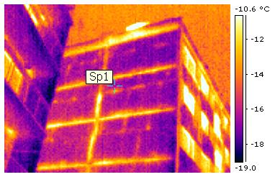
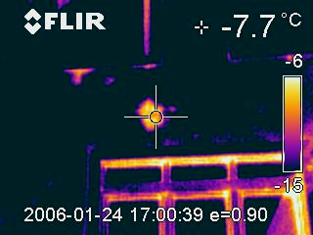
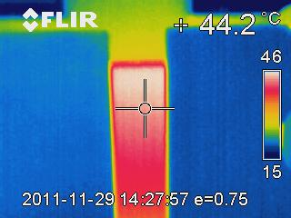
Energy saving
Thermal bridges elimination
Line bridges
3D bridges
In places location of thermal bridges are:
wzrost gęstości strumienia cieplnego,
obniżenie temperatury powierzchni wewnętrznej.

Slide 23
Improvement technology: workability & application technology
Durability: formation of new properties for products (e.q. nanotechnology - modification of traditional solutions)
pozzolanic effect
modification of polymers
density,
strength,
stiffness,
tightness
adhesion,
chemical resistance,
sealing,
crack-bridging
synergy
microfibers reinforcement
toughness,
crack resistance,
tensile strength

Slide 24
Role of fibers (carbon, polyacrylamide, glass, etc. fibers): - extremaly high elasticity, - longlasting durability,
Nanotechnology in ETICS:
Nanofibers: durability of top coats

Slide 25
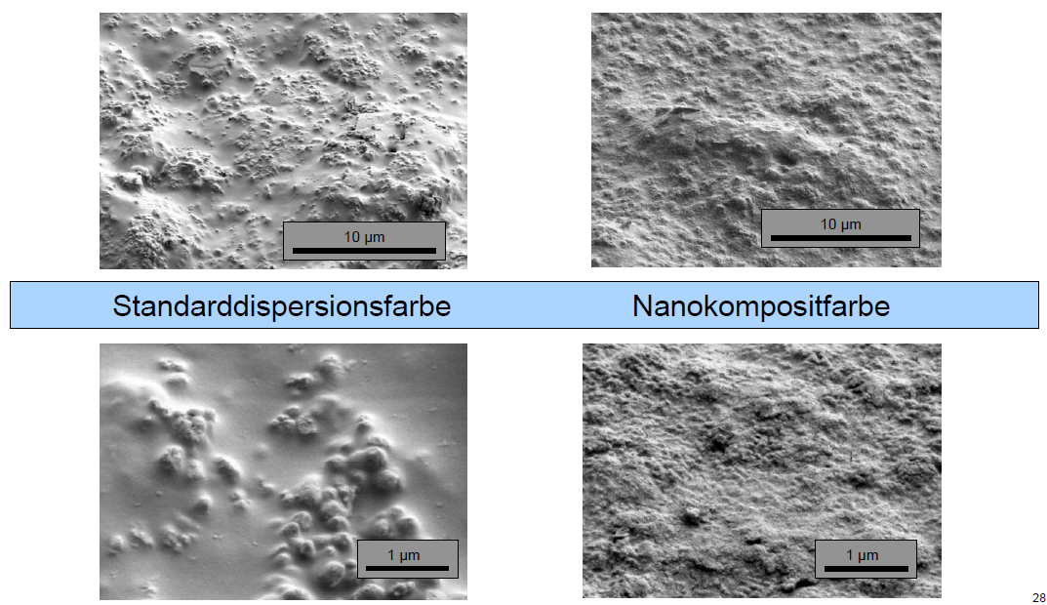
Nanotechnology in ETICS:
Nanodispersions: durability of top coats
Paints before ageing
Paints after ageing: 1000 cycles of Xeno-test

Slide 26
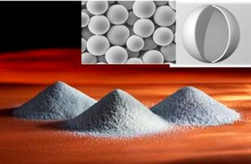
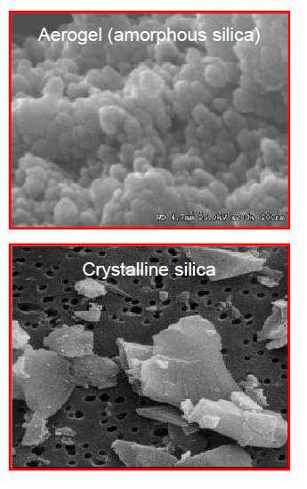
Nanotechnology in ETICS:
Nanofillers and aerogels: improvement durability and thermo properties

Slide 27
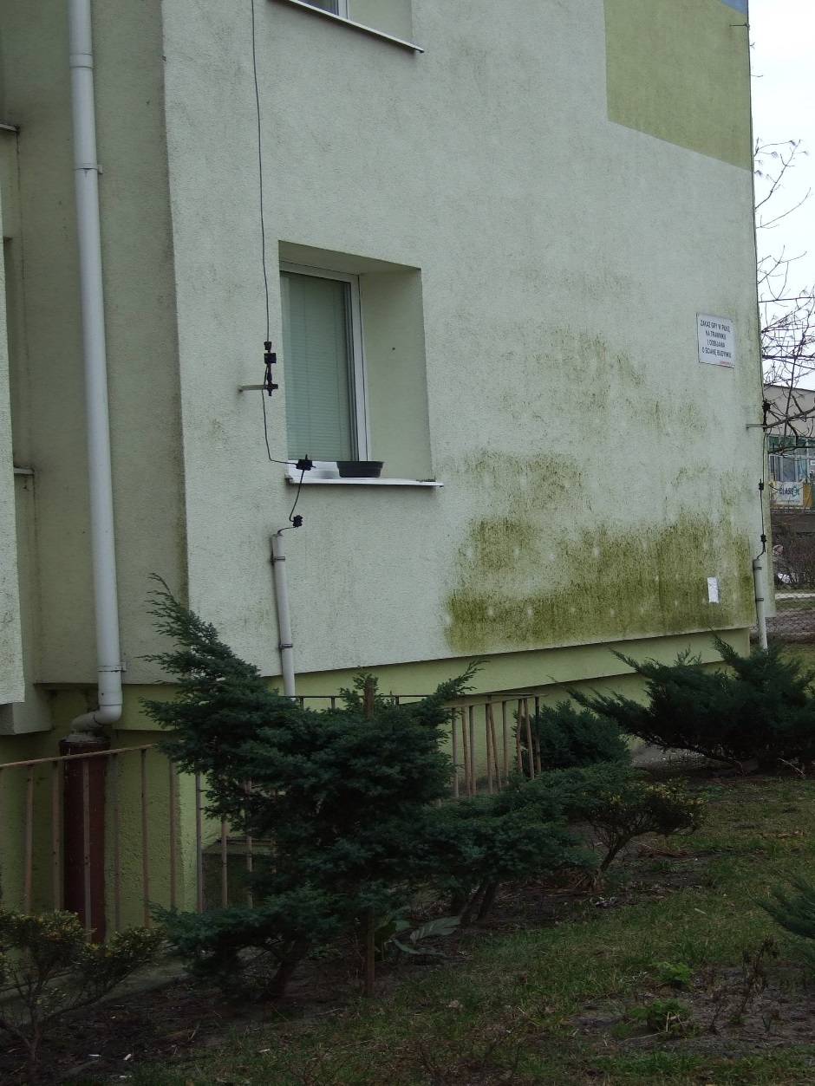
Nanotechnology in ETICS:
Bio nanocapsules: improvement of facade protection

Slide 28
Facade Solar Thermal Collector, Building integrated Photovoltaics – BiPV
Green energy technologies for ETICS

Slide 29
Thank You for Your attention

